Slide 1
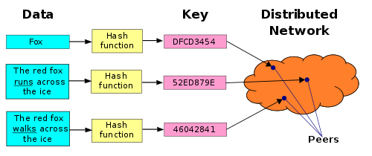
Distributed Hash Tables
CS 254:Design and Analysis of Algorithm
April 16, 2019
Sahil kumar(170001043) & Rohan Patel(170001040)

Slide 2
Introduction
In P2P systems, cooperative peers self-organize themselves into
overlay networks and relay/store data for each other
The major challenge is how to achieve ecient resource search in
these large-scale distributed-storage networks
2 types of overlays :
Unstructured
Structured

Slide 3
Introduction
Unstructured systems - do not impose any structure on the
overlay networks or loosely structured
E.g., Napster, Gnutella, Freenet, FastTrack, eDonkey2000, BitTorrent
Usually resilient to peer dynamics
Support complex search based on file metadata
Low search eciency, especially for unpopular files
Structured systems -impose particular structures on the overlay
networks
E.g., Distributed Hash Tables (DHTs)
The topology of the peer network is tightly controlled
Any files can be located in a small number of overlay hops

Slide 4
The Chord DHT
Chord is one of the four original DHT protocols, along with CAN, Tapestry and Pastry, and was developed at the MIT. Chord is also an algorithm for P2P DHT. It specifies how keys are assigned to nodes, and how a node can discover the value for a given key by first locating the node responsible for that key.

Slide 5
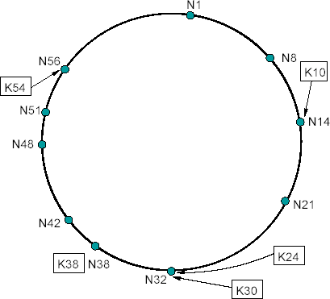
The Chord DHT
Chord ring: ID space mod 2¹⁶⁰
Node id = SHA1 (IP address, i)
for i = 1..v virtual IDs
Key id = SHA1 (name)
Routing correctness:
Each node knows successor and predecessor on ring
Routing eﬃciency:
Each node knows O(log n) well‐ distributed neighbours

Slide 6
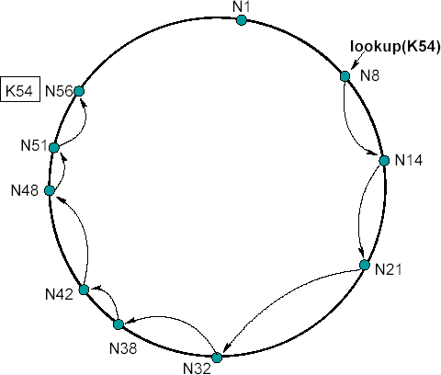
Basic Lookup In CHORD
21
lookup
if (
(id):
id > pred.id && id <= my.id )
return else
return
my.id;
Routing
succ.lookup(id);
Route hop by hop via successors
– O(n) hops to ﬁnd destination id

Slide 7
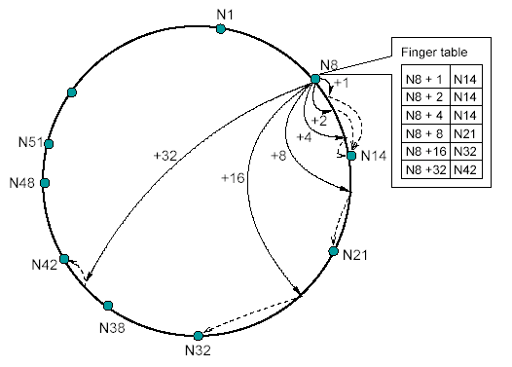
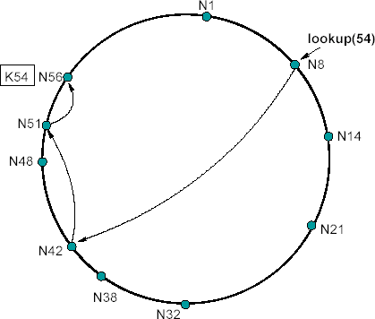
“Finger table” allows log N-time lookups
(like Binary search)
Routing Table
Routing
For i in 1...log n:
ﬁnger[i] = successor ( (my.id + 2i ) mod 2160

Slide 8
22
Eﬃcient lookup in Chord
lookup
if (
(id):
id > pred.id && id <= my.id )
return else
my.id;
Routing
// fingers() by decreasing distance
for finger in fingers():
if id <=
finger.id finger.lookup(id);
return
return succ.lookup(id);
Route greedily via distant “ﬁnger” nodes
– O(log n) hops to ﬁnd destination id

Slide 9
Failures may cause incorrect lookup
N120
N10
N113
N102
N85
Lookup(K90)
N80
N80 does not know correct successor, so incorrect lookup
9

Slide 10
Successor lists
Each node stores a list of its r immediate successors
After failure, will know first live successor
Correct successors guarantee correct lookups
Guarantee is with some probability
10

Slide 11
Choosing successor list length r
Assume one half of the nodes fail
P(successor list all dead) = (½)^{r}
i.e., P(this node breaks the Chord ring)
Depends on independent failure
Successor list of size r = O(log N) makes this probability 1/N: low for large N
11

Slide 12
Lookup with fault tolerance
Lookup(key-id):
look in local finger table and successor-list
for highest n: my-id < n < key-id
If n exists
call Lookup(key-id) on node n // nexthop
if call failed,
remove n from finger table and/or successor list
Return Lookup(key-id)
else
// done
return my successor
12

Slide 13
The CHORD LOOKUP SERVICE (Integration with DHash DHT, performance)
On top of Chord's routing layer, built the DHash block storage system. DHash provides a simple put and get interface to store and retrieve objects and handles reliable storage of data blocks on participating nodes. It does this through techniques such as replication and erasure coding.
The DHash DHT
Builds key/value storage on Chord
Replicates blocks for availability
Stores k replicas at the k successors after the block on the Chord ring
Caches blocks for load balancing
Client sends copy of block to each of the servers it contacted along the lookup path
Authenticates block contents

Slide 14
BLOCK AVAILABILITY
First, the file is broken into fixed block size. To increase data availability, DHash splits each block into 14 fragments using the IDA erasure code. Any 7 of these fragments are sufficient to reconstruct the block. DHash stores a block’s fragments on the 14 Chord nodes immediately following the block’s key. To maintain this proper placement of fragments, DHash transfers fragments between nodes as nodes enter and leave the system.
Basic API are- put(k, b) - Stores the block b under the key k, where k = SHA-1(b). get(k) - Fetches and returns the block associated with the key k.
Original block of size s , IDA splits the block into f fragments of size s/k . Any k(different k not key k) distinct fragments are sufficient to reconstruct the original block. Fragments are distinct if, in an information theoretic sense, they contain unique information.

Slide 15
The CHORD LOOKUP SERVICE (Integration with DHash DHT, performance)
DHash replicates blocks at r successors
N5
N110
N10
N20
N99
Block 17
N40
N80
N50
N68
N60
Replicas are easy to find if successor fails
Hashed node IDs ensure independent failure
48

Slide 16
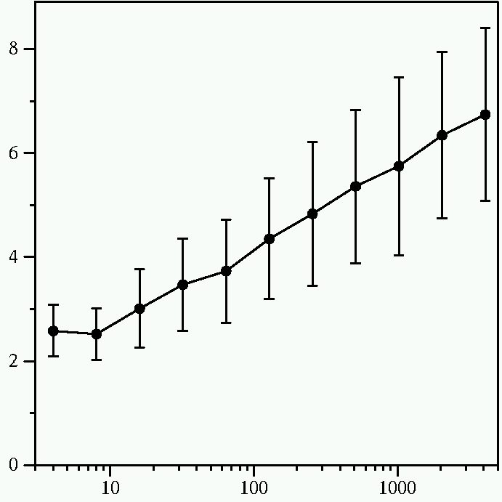
Chord lookup cost is O(log N)
Average Messages per Lookup
Number of Nodes
Constant is 1/2

